Slide 1

Video Stream Identification using Netfilter
Thomas Troy
February 2015
Dublin City University School of Electronic Engineering

Slide 2
Why Video?
Over 6 billion hours of video are watched each month on YouTube [1]
Online RTE viewership of the World Cup [2]
World Cup 2010 – 700,000 streams
World Cup 2014 - 2.5 million streams

Slide 3
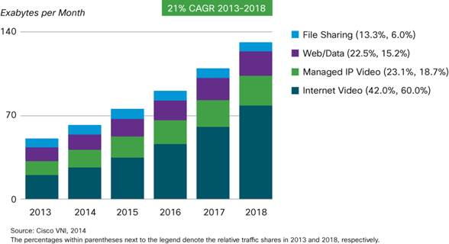
Why Video?
Cisco predict 79% of traffic will be video by 2018 [3]

Slide 4
Video Streaming Protocols
HTTP Streaming
Real Time Messaging Protocol (RTMP)
Real Time Transport Protocol (RTP) – RFC 3550
Video Calling (SIP)
Video Streaming (RTSP)
P2P
SopCast

Slide 5

Netfilter
Linux Firewall
Packet Filter
Stateful Firewall
NAT
Open source
Widely used
API to provide hooks into Linux networking stack
Notes:
Logo from http://netfilter.org/images/netfilter-logo2.png

Slide 6
Classification
Process to identify protocol of network traffic
Port Based
IANA assigned
Payload Based
Signature based on L7 payload of the packet
Statistical Based
Signature based on traffic flow of a connection

Slide 7
Proposed Solution
Statistical Protocol IDentification (SPID) – Erik Hjelmvik [5]
Hybrid Approach
Configurable

Slide 8
SPID
Protocol Model
Signature of the protocol
Contains multiple Attribute Meters

Slide 9
SPID – Attribute Meters
Measure of a flow or packet property
Payload based Attribute Meters
Byte Frequency for full packet
Byte Frequency for first X bytes
Flow based Attribute Meters
Packet size
Packet direction changes
Total bytes transferred

Slide 10

SPID – Comparing Models
Kullback-Leiber divergence
Relative Entropy
Measure of difference between two probability distributions
P = observed session’s probability distribution
Q = protocol model’s probability distribution
Lower K-L divergence is a better match

Slide 11
SPID – Improvements
Per-protocol Attribute Meter selection
Defining Limit
Lower limit on number of packets
Port based hints
Decide order of protocols for classification
Only useful after defining limit
Cut-Off Limit
Upper limit on number of packets

Slide 12
Tools Required
Reference Capture
Captures from network in pcap format
tcpdump
Training Program
Read pcap files from reference capture tool
Create protocol models and database
Classification Program
Netfilter Integration
Compare observed session with database

Slide 13
Verification
True Positive (TP)
Correctly classified as protocol
False Positive (FP)
Other protocol classified as this protocol
True Negative (TN)
Correctly classified as not this protocol
False Negative (FN)
Incorrectly classified as not this protocol

Slide 14
Project Plan
March
Reference capture tool creation
Training program to read pcap files
April
Formalise protocol database format
Training algorithm
Start of Netfilter layer
May
Finalise Netfilter layer
Start coding of SPID basic classification algorithm

Slide 15
Project Plan
June
Continued SPID algorithm development
Netfilter to SPID algorithm
July
Improvements to SPID algorithm
defining limit
port based order
Pcap to SPID algorithm
Continued development

Slide 16
Project Plan
August
Test traffic generation
Gathering classification results
September
Analysis of results

Slide 17

Questions?

Slide 18
References
[1] http://www.youtube.com/yt/press/statistics.html
[2] http://www.rte.ie/sport/soccer/worldcup/2014/0718/631727-rte-enjoys-a-record-breaking-world-cup/
[3] Cisco, (2014, February). Cisco Visual Networking index: Global Mobile data Traffic Forecast Update, 2013-2018. Avaliable: http://www.cisco.com/c/en/us/solutions/collateral/service-provider/visual-networking-index-vni/white_paper_c11-520862.pdf
[4] http://netfilter.org/images/netfilter-logo2.png
[5] Hjelmvik, E. (2008). The spid algorithm-statistical protocol identification. Gävle, Sweden.

